Slide 1
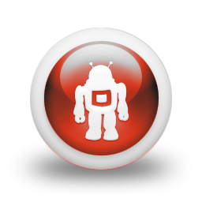

THE ROBOTICS REVOLUTION: THE RPA HACKATHON IS COMING…
More and more clients around the country are asking us about Robotic Process Automation (RPA). Sogeti and the Capgemini Group have years of experience in large-scale implementations and the RPA space is heating up quickly.
With RPA improving in its capabilities for automating business processes, the I&D Team has decided it’s a great time to introduce software robotics and to conduct a Hackathon that should prove challenging and very interesting.
Join us for a presentation by Doug Ross, National Solutions Architect for RPA and AI. Doug will cover the following topics:
What is RPA?
How do large companies use RPA?
What do you mean by an RPA Hackathon?
What is the structure of the Hackathon challenge?
Finally, what are the key dates of the Hackathon?
INTERESTED IN FINDING OUT MORE? JUST HIT THE REPLY BUTTON

